Slide 1
Transport Layer – Part II
Computer Communications and Networks
ITCS 6166/8166
Dr. Dewan Tanvir Ahmed
Department of Computer Science
University of North Carolina at Charlotte

Slide 2
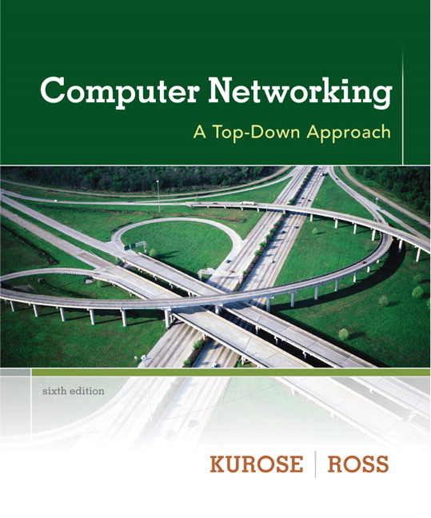

Chapter 3 Transport Layer
Computer Networking: A Top Down Approach 6th edition Jim Kurose, Keith Ross Addison-Wesley March 2012
A note on the use of these ppt slides:
We’re making these slides freely available to all (faculty, students, readers). They’re in PowerPoint form so you see the animations; and can add, modify, and delete slides (including this one) and slide content to suit your needs. They obviously represent a lot of work on our part. In return for use, we only ask the following:
If you use these slides (e.g., in a class) that you mention their source (after all, we’d like people to use our book!)
If you post any slides on a www site, that you note that they are adapted from (or perhaps identical to) our slides, and note our copyright of this material.
Thanks and enjoy! JFK/KWR
All material copyright 1996-2012
J.F Kurose and K.W. Ross, All Rights Reserved

Slide 3

Chapter 23
Introduction
To
Transport Layer
Copyright © The McGraw-Hill Companies, Inc. Permission required for reproduction or display.

Slide 4
Chapter 3 outline
3.1 transport-layer services
3.2 multiplexing and demultiplexing
3.3 connectionless transport: UDP
3.4 principles of reliable data transfer
3.5 connection-oriented transport: TCP
segment structure
reliable data transfer
flow control
connection management
3.6 principles of congestion control
3.7 TCP congestion control

Slide 5
TCP: Overview RFCs: 793,1122,1323, 2018, 2581
Connection-oriented:
handshaking (exchange of control msgs) inits sender and receiver state before data exchange
Full duplex data:
bi-directional data flow in same connection
MSS: maximum segment size (next slide)
Point-to-point:
one sender & one receiver
Flow controlled:
sender will not overwhelm receiver
Reliable, in-order byte steam:
no message boundaries
Pipelined:
TCP congestion and flow control set window size

Slide 6
MSS- Maximum Segment Size
MSS - The maximum amount of data that can be grabbed and placed in a segment
Typically set by the largest link-layer frame
so-called maximum transmission unit, MTU
setting the MSS to ensure that a TCP segment (when encapsulated in an IP datagram) plus the TCP/ IP header length (typically 40 bytes) will fit into a single link- layer frame.
Both Ethernet and PPP link-layer protocols have an MTU of 1,500 bytes.

Slide 7
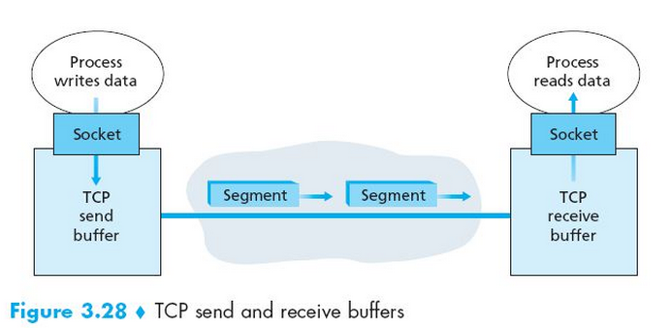
MSS- Maximum Segment Size
A TCP connection consists of
buffers, variables, and a socket connection to a process in one host, and
another set of buffers, variables, and a socket connection to a process in another host.
Note. no buffers or variables are allocated to the connection in the network elements (e.g. routers, switches, and repeaters) between the hosts

Slide 8
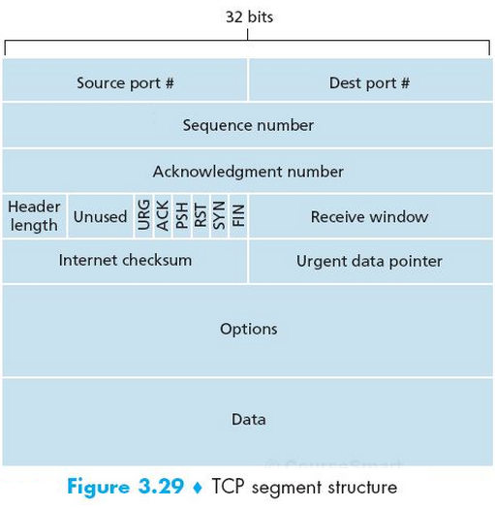
TCP segment structure
URG: urgent data
(generally not used)
Counting by bytes
of data (not segments!)
ACK: ACK # valid
PSH: push data now
(generally not used)
RST, SYN, FIN:
connection estab
(setup, teardown
commands)
# of bytes rcvr willing to accept
Internet checksum
(as in UDP)

Slide 9
TCP Flag Fields
The flag field contains 6 bits.
ACK bit –
indicates that the value carried in the acknowledgment field is valid
RST, SYN, and FIN bits
used for connection setup and teardown
PSH bit
indicates that the receiver should pass the data to the upper layer immediately.
URG bit
there is data in this segment that the sending- side upper-layer entity has marked as urgent
The location of the last byte of this urgent data is indicated by the 16- bit urgent data pointer field.

Slide 10
TCP seq. numbers, ACKs
outgoing segment from sender
source port #
dest port #
sequence numbers:
byte stream number of first byte in segment’s data
32-bit
acknowledgements:
seq # of next byte expected from other side (32-bit)
cumulative ACK
Q: how receiver handles out-of-order segments
A: TCP spec doesn’t say, - up to implementer
sequence number
acknowledgement number
rwnd
checksum
urg pointer
window size
N
sender sequence number space
sent
ACKed
sent, not-yet ACKed
(“in-flight”)
usable
but not
yet sent
not
usable
incoming segment to sender
source port #
dest port #
sequence number
acknowledgement number
A
rwnd
checksum
urg pointer

Slide 11

TCP seq. numbers, ACKs
Host A
Host B
User
types
‘C’
Seq=42, ACK=79, data = ‘C’
host ACKs receipt of
‘C’, echoes back ‘C’
Seq=79, ACK=43, data = ‘C’
host ACKs receipt
of echoed ‘C’
Seq=43, ACK=80
simple telnet scenario

Slide 12
TCP round trip time & timeout
Q: how to set TCP timeout value?
longer than RTT
but RTT varies
too short: premature timeout, unnecessary retransmissions
too long: slow reaction to segment loss
Q: how to estimate RTT?
SampleRTT: measured time from segment transmission until ACK receipt
ignore retransmissions
SampleRTT will vary, want estimated RTT “smoother”
average several recent measurements, not just current SampleRTT

Slide 13
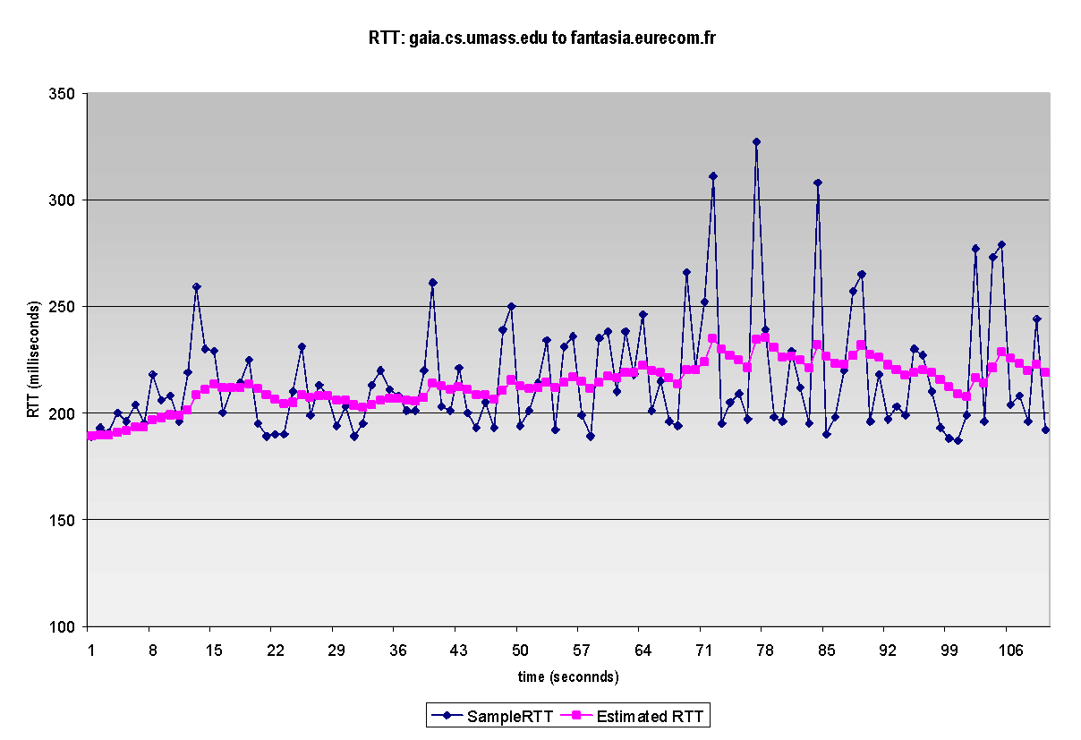
TCP round trip time, timeout
EstimatedRTT = (1- α)*EstimatedRTT + α*SampleRTT
exponential weighted moving average
influence of past sample decreases exponentially fast
typical value: α = 0.125
RTT: gaia.cs.umass.edu to fantasia.eurecom.fr
RTT (milliseconds)
sampleRTT
EstimatedRTT
time (seconds)

Slide 14

TCP round trip time, timeout
timeout interval: EstimatedRTT plus “safety margin”
large variation in EstimatedRTT -> larger safety margin
estimate SampleRTT deviation from EstimatedRTT:
DevRTT = (1-β)*DevRTT +
β*|SampleRTT-EstimatedRTT|
(typically, β = 0.25)
TimeoutInterval = EstimatedRTT + 4*DevRTT
estimated RTT
“safety margin”

Slide 15
Chapter 3 outline
3.1 transport-layer services
3.2 multiplexing and demultiplexing
3.3 connectionless transport: UDP
3.4 principles of reliable data transfer
3.5 connection-oriented transport: TCP
segment structure
reliable data transfer
flow control
connection management
3.6 principles of congestion control
3.7 TCP congestion control

Slide 16
TCP reliable data transfer
TCP creates rdt service on top of IP’s unreliable service
Pipelined segments
Cumulative ACKs
Single retransmission timer
Retransmissions triggered by:
Timeout events
Duplicate ACKs
Let’s initially consider simplified TCP sender:
ignore duplicate acks
ignore flow control, congestion control

Slide 17
TCP sender events:
data rcvd from app:
create segment with seq #
seq # = byte-stream number of the first data byte in segment
start timer if not already running
timer as for oldest unacked segment
expiration interval: TimeoutInterval
timeout:
retransmit segment that caused timeout
restart timer
ack rcvd:
if ack acknowledges previously unacked segments
update what is known to be ACKed
start timer if there are still unacked segments

Slide 18
TCP sender (simplified)
data received from application above
create segment, seq. #: NextSeqNum
pass segment to IP (i.e., “send”)
NextSeqNum = NextSeqNum + length(data)
if (timer currently not running)
start timer
Λ
NextSeqNum = InitialSeqNum
SendBase = InitialSeqNum
wait
for
event
timeout
retransmit not-yet-acked segment with smallest seq. #
start timer
ACK received, with ACK field value y
if (y > SendBase) {
SendBase = y
/* SendBase–1: last cumulatively ACKed byte */
if (there are currently not-yet-acked segments)
start timer
else stop timer
}

Slide 19
TCP: retransmission scenarios
Host A
Host B
Host A
Host B
SendBase=92
Seq=92, 8 bytes of data
Seq=92, 8 bytes of data
Seq=100, 20 bytes of data
timeout
ACK=100
timeout
X
ACK=100
ACK=120
Seq=92, 8 bytes of data
Seq=92, 8
bytes of data
SendBase=100
SendBase=120
ACK=100
ACK=120
SendBase=120
lost ACK scenario
premature timeout

Slide 20
TCP: retransmission scenarios
Host A
Host B
Seq=92, 8 bytes of data
Seq=100, 20 bytes of data
timeout
ACK=100
X
ACK=120
Seq=120, 15 bytes of data
cumulative ACK

Slide 21
TCP ACK generation [RFC 1122, RFC 2581]
event at receiver
arrival of in-order segment with
expected seq #. All data up to
expected seq # already ACKed
arrival of in-order segment with
expected seq #. One other
segment has ACK pending
arrival of out-of-order segment
higher-than-expect seq. # .
Gap detected
arrival of segment that
partially or completely fills gap
TCP receiver action
delayed ACK.
Wait up to 500ms for next segment.
If no next segment, send ACK
immediately send single cumulative
ACK, ACKing both in-order segments
immediately send duplicate ACK,
indicating seq. # of next expected byte
immediate send ACK, provided that
segment starts at lower end of gap

Slide 22
TCP Fast Retransmit
time-out period often relatively long:
long delay before resending lost packet
detect lost segments via duplicate ACKs.
sender often sends many segments back-to-back
if segment is lost, there will likely be many duplicate ACKs.
TCP fast retransmit
if sender receives 3 ACKs for same data (“triple duplicate ACKs”), resend unacked segment with smallest seq #
likely that unacked segment lost, so don’t wait for timeout

Slide 23
TCP fast retransmit
Host A
Host B
Seq=92, 8 bytes of data
Seq=100, 20 bytes of data
X
ACK=100
timeout
ACK=100
ACK=100
ACK=100
Seq=100, 20 bytes of data
fast retransmit after sender receipt of triple duplicate ACK

Slide 24
Chapter 3 outline
3.1 transport-layer services
3.2 multiplexing and demultiplexing
3.3 connectionless transport: UDP
3.4 principles of reliable data transfer
3.5 connection-oriented transport: TCP
segment structure
reliable data transfer
flow control
connection management
3.6 principles of congestion control
3.7 TCP congestion control

Slide 25
TCP flow control
application
process
application may
remove data from
TCP socket buffers ….
application
TCP socket
receiver buffers
OS
… slower than TCP
receiver is delivering
(sender is sending)
TCP
code
flow control
receiver controls sender, so sender won’t overflow receiver’s buffer by transmitting too much, too fast
IP
code
from sender
receiver protocol stack

Slide 26
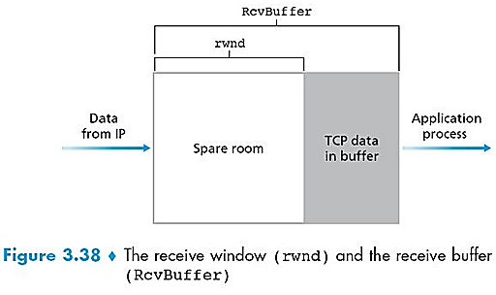
TCP flow control
receiver “advertises” free buffer space by including rwnd value in TCP header of receiver-to-sender segments
RcvBuffer size set via socket options (typical default is 4096 bytes)
many operating systems autoadjust RcvBuffer
sender limits amount of unacked (“in-flight”) data to receiver’s rwnd value
guarantees receive buffer will not overflow

Slide 27
Chapter 3 outline
3.1 transport-layer services
3.2 multiplexing and demultiplexing
3.3 connectionless transport: UDP
3.4 principles of reliable data transfer
3.5 connection-oriented transport: TCP
segment structure
reliable data transfer
flow control
connection management
3.6 principles of congestion control
3.7 TCP congestion control

Slide 28
Connection Management
Before exchanging data, sender/receiver “handshake”:
agree to establish connection
agree on connection parameters
application
application
connection state: ESTAB
connection variables:
seq # client-to-server
server-to-client
rcvBuffer size
at server,client
connection state: ESTAB
connection Variables:
seq # client-to-server
server-to-client
rcvBuffer size
at server,client
network
network
Socket clientSocket =
newSocket("hostname","port number");
Socket connectionSocket = welcomeSocket.accept();

Slide 29
TCP 3-way handshake
TCP SYN segment
client state
server state
LISTEN
LISTEN
choose init seq num, x
send TCP SYN msg
SYNSENT
SYNbit=1, Seq=x
SYNACK segment.
choose init seq num, y
send TCP SYNACK
msg, acking SYN
SYN RCVD
SYNbit=1, Seq=y
ACKbit=1; ACKnum=x+1
received SYNACK(x)
indicates server is live;
send ACK for SYNACK;
this segment may contain
client-to-server data
ESTAB
ACKbit=1, ACKnum=y+1
received ACK(y)
indicates client is live
ESTAB

Slide 30
TCP: closing a connection
Client and server each close their side of connection
send TCP segment with FIN bit = 1
Respond to received FIN with ACK
on receiving FIN, ACK can be combined with own FIN
Simultaneous FIN exchanges can be handled

Slide 31
TCP: closing a connection
client state
server state
ESTAB
ESTAB
clientSocket.close()
FIN_WAIT_1
can no longer
send but can
receive data
FINbit=1, seq=x
CLOSE_WAIT
ACKbit=1; ACKnum=x+1
can still
send data
FIN_WAIT_2
wait for server
close
LAST_ACK
FINbit=1, seq=y
TIMED_WAIT
can no longer
send data
ACKbit=1; ACKnum=y+1
timed wait
for 2*max
segment lifetime
CLOSED
The TIME_WAIT state lets the TCP client resend the final acknowledgment in case the ACK is lost.
CLOSED

Slide 32
Chapter 3 outline
3.1 transport-layer services
3.2 multiplexing and demultiplexing
3.3 connectionless transport: UDP
3.4 principles of reliable data transfer
3.5 connection-oriented transport: TCP
segment structure
reliable data transfer
flow control
connection management
3.6 principles of congestion control
3.7 TCP congestion control

Slide 33
Principles of congestion control
Congestion:
informally: “too many sources sending too much data too fast for network to handle”
different from flow control!
manifestations:
lost packets (buffer overflow at routers)
long delays (queueing in router buffers)
a top-10 problem!

Slide 34
Approaches towards congestion control
two broad approaches towards congestion control:
end-to-end congestion control:
network-assisted congestion control:
routers provide feedback to end systems
single bit indicating congestion (SNA, DECbit, TCP/IP ECN, ATM)
explicit rate for sender to send at
no explicit feedback from network
congestion inferred from end-system observed loss, and delay
approach taken by TCP

Slide 35
Chapter 3 outline
3.1 transport-layer services
3.2 multiplexing and demultiplexing
3.3 connectionless transport: UDP
3.4 principles of reliable data transfer
3.5 connection-oriented transport: TCP
segment structure
reliable data transfer
flow control
connection management
3.6 principles of congestion control
3.7 TCP congestion control

Slide 36
TCP congestion control: Additive Increase Multiplicative Decrease (AIMD)
approach: sender increases transmission rate (window size), probing for usable bandwidth, until loss occurs
additive increase: increase cwnd by 1 MSS every RTT until loss detected
multiplicative decrease: cut cwnd in half after loss
additively increase window size …
…. until loss occurs (then cut window in half)
AIMD saw tooth
behavior: probing
for bandwidth
cwnd: TCP sender
congestion window size
time

Slide 37
TCP Congestion Control: Details
sender sequence number space
TCP sending rate:
roughly: send cwnd bytes, wait RTT for ACKS, then send more bytes
cwnd
last byte
ACKed
last byte sent
sent, not-yet ACKed
(“in-flight”)
rate
cwnd
~
bytes/sec
sender limits transmission:
cwnd is dynamic, function of perceived network congestion
~
RTT
<
cwnd
ASSUME, TCP receive buffer is so large AND IGNORE the receive-window constraint
So, the amount of unacknowledged data at the sender is solely limited by cwnd.
LastByteSent- LastByteAcked

Slide 38
TCP Slow Start
when connection begins, increase rate exponentially until first loss event:
initially cwnd = 1 MSS
double cwnd every RTT
done by incrementing cwnd for every ACK received
summary: initial rate is slow but ramps up exponentially fast
Host A
Host B
one segment
RTT
two segments
four segments
time

Slide 39
TCP: Detecting and reacting to loss
Loss indicated by timeout:
cwnd set to 1 MSS;
window then grows exponentially (as in slow start) to threshold, then grows linearly
Loss indicated by 3 duplicate ACKs: TCP RENO
dup ACKs indicate network capable of delivering some segments
cwnd is cut in half window then grows linearly
TCP Tahoe always sets cwnd to 1 (timeout or 3 duplicate acks)

Slide 40
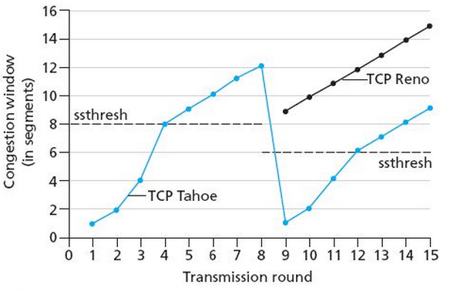
TCP: switching from slow start to congestion avoidance (CA)
Q: when should the exponential increase switch to linear?
A: when cwnd gets to 1/2 of its value before timeout.
Implementation:
variable ssthresh (slow start threshold)
on loss event, ssthresh is set to 1/2 of cwnd just before loss event

Slide 41


Summary: TCP Congestion Control
New
ACK!
new ACK
New
ACK!
duplicate ACK
.
dupACKcount++
new ACK
cwnd = cwnd + MSS (MSS/cwnd)
dupACKcount = 0
transmit new segment(s), as allowed
cwnd = cwnd+MSS
dupACKcount = 0
transmit new segment(s), as allowed
Λ
cwnd = 1 MSS
ssthresh = 64 KB
dupACKcount = 0
cwnd > ssthresh
slow
start
Λ
congestion
avoidance
timeout
ssthresh = cwnd/2
cwnd = 1 MSS
dupACKcount = 0
retransmit missing segment
duplicate ACK
timeout
dupACKcount++
ssthresh = cwnd/2
cwnd = 1 MSS
dupACKcount = 0
retransmit missing segment
timeout
New
ACK!
ssthresh = cwnd/2
cwnd = 1
dupACKcount = 0
retransmit missing segment
New ACK
dupACKcount == 3
cwnd = ssthresh
dupACKcount = 0
dupACKcount == 3
ssthresh= cwnd/2
cwnd = ssthresh + 3
retransmit missing segment
ssthresh= cwnd/2
cwnd = ssthresh + 3
retransmit missing segment
fast
recovery
duplicate ACK
cwnd = cwnd + MSS
transmit new segment(s), as allowed
Notes:
Example: MSS =

Slide 42
TCP throughput
avg. TCP throughput as function of window size and RTT?
ignore slow start, assume always data to send
W: window size (measured in bytes) where loss occurs
avg. window size (# in-flight bytes) is ¾ W
avg. thruput is 3/4W per RTT
avg TCP thruput =
3
W
4
RTT
bytes/sec
W
W/2

Slide 43
TCP Futures: TCP over long and fat pipes
throughput in terms of segment loss probability, L [Mathis 1997]: Example: 1500 byte segments, 100ms RTT, want 10 Gbps throughput
➜ to achieve 10 Gbps throughput, need a loss rate of L = 2·10⁻¹⁰ – a very small loss rate!
new versions of TCP for high-speed
1.22
.
MSS
TCP throughput =
RTT
L

Slide 44
TCP Fairness
fairness goal: if K TCP sessions share same bottleneck link of bandwidth R, each should have average rate of R/K
TCP connection 1
bottleneck
router
capacity R
TCP connection 2

Slide 45
Why is TCP fair?
Two competing sessions:
additive increase gives slope of 1, as throughout increases
multiplicative decrease decreases throughput proportionally
R
Full bandwidth utilization line
equal bandwidth share
Connection 2 throughput
loss: decrease window by factor of 2
congestion avoidance: additive increase
loss: decrease window by factor of 2
congestion avoidance: additive increase
Connection 1 throughput
R

Slide 46
Fairness (more)
Fairness and UDP
multimedia apps often do not use TCP
do not want rate throttled by congestion control
instead use UDP:
send audio/video at constant rate, tolerate packet loss
Fairness, parallel TCP connections
application can open multiple parallel connections between two hosts
web browsers do this
e.g., link of rate R with 9 existing connections:
new app asks for 1 TCP, gets rate R/10
new app asks for 9 TCPs, gets R/2

Slide 47
Thank you!

